Slide 1
Hortonworks & Big Data Career Paths & Training
Aengus Rooney
Solutions Engineering

Slide 2

Hortonworks Influences the Apache Community
We Employ the Committers one third of all committers to the Apache® Hadoop™ project, and a majority in other important projects
Our Committers Innovate and expand Open Enterprise Hadoop
We Influence the Hadoop Roadmap by communicating important requirements to the community through our leaders
Apache Hadoop Committers

Slide 3


Hortonworks Nourishes the Community and Ecosystem
Hortonworks Community Connection
Hadoop & Big data ecosystem
Hortonworks Partnerworks
Community Q/A Resources
Articles & Code Repos!
Community of (big data) developers
Open Ecosystem of Big Data for vendors & end-users
Advance Apache™ Hadoop®
Enable more Big Data Apps
World class partner program
Network of partners providing best-in-class solutions

Slide 4
Hortonworks Provides Full Lifecycle Support
Hortonworks Expertise from the original architects of Apache Hadoop and Apache NiFi
Annual Subscriptions align your success with ours
Apache Committers advocate for the requirements of our customers and provide them roadmap visibility to help guide their journey
Expert Consulting and Training help you and your team get the most from your Open Data Platforms
Project 5
Project 1
Project 3
Project 6
DEPLOY
EXPAND
Project 4
storage
storage
Project 2
ARCHITECT
&
DEVELOP
OPERATE

Slide 5

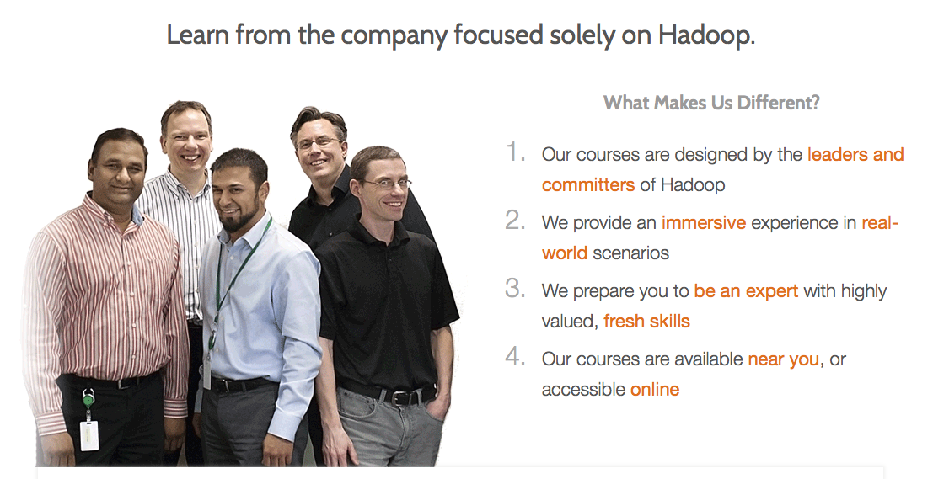
Hortonworks University
Hortonworks University provides valuable real world scenario-based training developed by the core architects, builders and operators of Apache Hadoop. Courses offer unmatched depth and expertise and are available both in classroom or online from anywhere in the world.

Slide 6
Start Your Journey with Hortonworks in 5 Easy Steps
Schedule a use case workshop with the Hortonworks team
Download Hortonworks Sandbox – hortonworks.com/sandbox
Subscribe for Support – hortonworks.com/services/jumpstart/
Join Hortonworks Community Connection – hortonworks.com/community/
Follow the Hortonworks blog – hortonworks.com/blog/

Slide 7
Open Source = Readily Available Resources!
Full Apache Hadoop Ecosystem
https://hadoopecosystemtable.github.io/
Apache Hadoop
http://hadoop.apache.org/
Hortonworks Data Platform
http://hortonworks.com/products/hdp/
Hortonworks Data Flow (Nifi, Kafka, Storm)
http://hortonworks.com/products/hdf/
Blog
http://hortonworks.com/blog/
Webinars
http://hortonworks.com/webinars/

Slide 8
Open Source = Readily Available Resources!
Community Forum
https://community.hortonworks.com/answers/index.html
Downloads (full HDP and HDF stack, sandbox for VMs)
http://hortonworks.com/downloads/
Documentation
http://docs.hortonworks.com/index.html
AWS deployment
http://hortonworks.com/blog/deploying-hadoop-cluster-amazon-ec2-hortonworks/
Azure Deployment
https://azure.microsoft.com/en-us/marketplace/partners/hortonworks/hortonworks-data-platform-standardnodedriven/
HWX Developers Home
http://hortonworks.com/developers/

Slide 9
Open Source = Readily Available Resources!
HWX UNI Git Repos
https://github.com/HortonworksUniversity
HWX Tutorials
http://hortonworks.com/tutorials/
HWX Tutorials Git
https://github.com/hortonworks/hadoop-tutorials
HWX Repos Gallery
https://community.hortonworks.com/gallery/list.html
HWX Developer Git
https://github.com/hortonworks-gallery
Other Resources…
Java, Scala, Python, R, Coursera, EDX, etc etc etc …
HWX Training
http://hortonworks.com/training/

Slide 10
Hortonworks University Overview
Public, Private onsite and Virtual led courses
Self Paced Learning Library
Global delivery capability
Learning Paths: Developers, Administrators, and Data Analysts
Industry-leading Lecture AND hands-on labs
Certifications (New Performance Based exams)
http://hortonworks.com/training

Slide 11

Training Delivery
Private Onsite: ideal for groups of 6 or more, flexible content and delivery (can also be done as virtual)
Public: ideal for individuals or small groups, classroom + virtual
High Definition Instructor Led Training (HD-ILT)
35+ training locations across North America
Virtual remote option from home or office
Certified Hortonworks Instructors
Official Hortonworks Training Curriculum
GAURANTEED TO RUN SCHEDULE

Slide 12


Hortonworks University Training Partners
Hortonworks Certified Training Partner program authorizes world-class 3rd-party training companies to resell and deliver our onsite and public training services across the globe on behalf of Hortonworks.
Americas
Cetax (dba TutorPro), Brazil
GCA Technology Services, United States
iNDT, Brazil
Prognosive, United States
SimaFore, United States
Sunset Learning Institute, United States
UMBC /training/etc, United States
* 6 new additional partners coming in Mexico and South America
EMEA
Big Data Partnership, United Kingdom
Bilginc IT Academy, Turkey
Codecentric AG, Germany
Cornerstone, Sweden
eCube, Italy
Guruteam, Ireland
Linux Polska, Poland
MHM Computer, Prague
Netmind, Spain
Obsidian Systems, South Africa
OCTO Technology, France
QA, United Kingdom
Valtech, France
APAC
Avantus, Singapore
byres, Malaysia
Contexti, Australia
HanSight, China
Japan Third Party, Japan
RCS Education, India
SEED InfoTech, India
SpringPeople, India
TipDM Intelligent Technology, China
Xiilab, South Korea

Slide 13
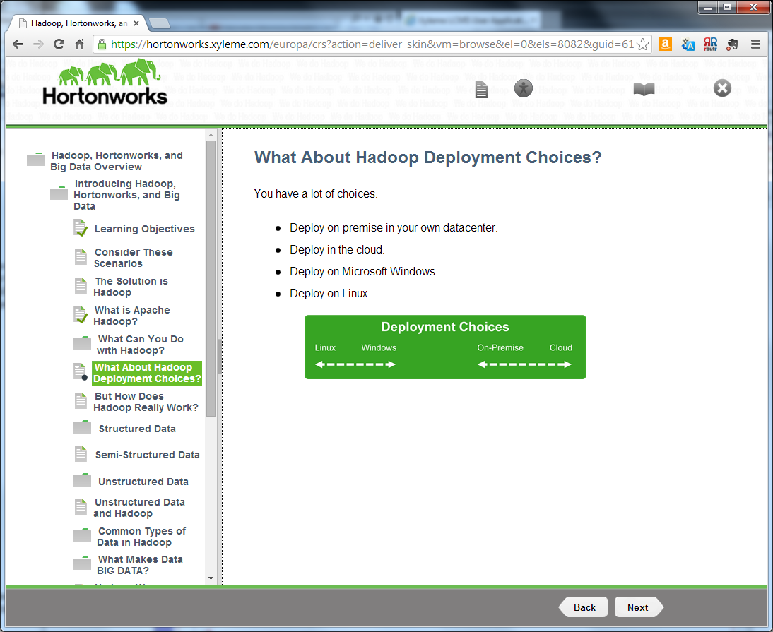
Self-Paced Training
On demand learning library
Start and stop at your own pace or as needed
Detailed click through reading content
Includes lab exercises and downloadable VM lab environment
12 month named user subscription
Access to over 500 hrs of content and labs from all Hortonworks University classes
http://hortonworks.com/training/class/hortonworks-university-self-paced-learning-library/

Slide 14
Hadoop Role-based Training Curriculum
New to Hadoop
Developers
Administrators
Data Analysts
HDP Overview:
Essentials
HDP Developer:
Apache Pig and Hive
HDP Operations:
Hadoop Administration I
HDP Analyst:
Data Science
8 Hours – on line only
4 Days
4 Days
3 Days
Self Paced Learning Library:
On Line Training Modules
HDP Developer:
Windows
HDP Operations:
Hadoop Administration II
HDP Analyst:
HBase Essentials
NEW
At your own pace
4 Days
3 Days
2 Days
HDP Developer:
Enterprise Spark I
HDF Operations:
Hortonworks Data Flow
NEW
NEW
4Days
3 Days
HDP Developer:
Java
HDP Operations:
Security
NEW
4 Days
3 Days
HDP Developer:
Custom YARN Applications
HDP Operations:
HBase Advanced Management
2 Days
4 Days
HDP Developer:
Storm and Trident
HDP Operations:
Migrating to the HDP Platform
2 Days
2 Days

Slide 15
Hortonworks University: HDP Training Portfolio
Hadoop Essentials | Self-Paced | Get an overview of Apache Hadoop for decision makers and business users. | Data architects, integration architects, managers, C-level executives, technical infrastructure team
Developer: Windows | 4 Days | Designed for developers who create applications and analyze Big Data in Apache Hadoop on Windows using Pig and Hive. Topics include: Hadoop, YARN, the Hadoop, Distributed File System (HDFS), MapReduce, Sqoop and the HiveODBC Driver | Software developers who need to understand and develop applications for Hadoop 2.x on Windows.
Developer: Pig & Hive | 4 Days | Learn to develop applications and analyze Big Data stored in Apache Hadoop 2.0 using Pig and Hive. | Data Analysts, BI Analysts, BI Developers, SAS Developers and other developers.
Developer: Java | 4 Days | Learn to design and develop efficient and effective MapReduce applications. | Java software engineers who need to understand and develop Java MapReduce applications.
Developer: Custom YARN Applications | 2 Days | Learn the details of the YARN architecture, the steps involved in writing a YARN application, the details of writing a YARN client and ApplicationMaster, and how to launch Containers. | Software engineers familiar with Java who need to develop YARN applications on Hadoop 2.x by writing custom YARN clients and ApplicationMasters in Java.
Developer: Enterprise Spark I | 4 Days | Designed for developers who need to create applications to analyze Big Data in Apache Hadoop using Spark. | Architects, software developers, analysts and data scientists.
Developer: Storm & Trident | 2 Days | This course provides a technical introduction to the fundamentals of Apache Storm and Trident that includes the concepts, terminology, architecture, installation, operation and management of Storm and Trident. | Software engineers that are looking to develop time sensitive applications for Hadoop. Hadoop developers who need to be able to design and build Storm and Kafka applications using Java and Trident API
Operations: Hadoop Administration I | 4 Days | Designed for administrators who will be managing the Hortonworks Data Platform (HDP). It covers installation, configuration, maintenance, security and performance | IT administrators and operators responsible for installing, configuring and supporting an Apache Hadoop 2.0 deployment in a Linux environment.

Slide 16
Hortonworks University: HDP Training Portfolio
Operations: Hadoop Administration II | 3 Days | Designed for experienced adminstrators who manage Hortonworks Data Platform (HDP) 2.3 clusters with Ambari. It covers upgrades, configuratio, application management, and other common tasks. | IT administrators and operators responsible for installing, configuring and supporting an Apache Hadoop 2.3 deployment in a Linux environment.
Operations: Migrating to the Hortonworks Data Platform | 2 Days | Designed for administrators who are familiar with administering other Hadoop distributions and are migrating to the Hortonworks Data Platform (HDP). It covers installation, configuration, maintenance, security and performance topics | Experienced Hadoop administrators and operators responsible for installing, configuring, and supporting the Hortonworks Data Platform.
Operations: Apache Hbase Advanced Management | 4 Days | Designed for administrators who will be installing, configuring, and managing HBase clusters. It covers installation with Ambari, configuration, security, and troubleshooting. | Architects, software developers, and analyst responsible for implementing non-SQL databases in order to handle sparse data sets commonly found in big data use cases
Operations: Security | 3 Days | This course is designed for experienced administrators who will be implementing secure Hadoop clusters using authentication, authorization, auditing and data protection strategies and tools. | IT administrators and operators responsible for installing, configuring and supporting an Apache Hadoop 2.3 deployment in a Linux environment.
Operations: Hortonworks DataFlow | 3 Days | Designed for “Data Stewards” or “Data Flow Managers” who are looking forward to automate the flow of data between systems. Topics include intro to NiFi, installing and configuring NiFi, detailed explanation of NiFi User Interface and explanation of components | Data Engineers, Integration Engineers, Data Scientists, and Architects who are looking to automate Data Flow between systems
Analyst: HBase Essentials | 2 Days | Designed for big data analysts who want to use the NoSQL database, which runs on top of HDFS to provide real-time read/write access to sparse data sets. Topics include HBase architecture, services, installation and schema design | Architects, software developers, and analysts responsible for implementing non-SQL databases in order to handle sparse data sets commonly found in big data use cases
Analyst: Data Science | 3 Days | Learn how to develop Data Science applications for Big Data on a Hadoop cluster using Pig and Python Machine Learning libraries including NumPy, SciPy and scikit-learn | Architects, software developers, analysts and data scientists who need to apply data science and machine learning on Hadoop.

Slide 17

Current Certification Exams
COMING SOON: Hortonworks Certified Associate

Slide 18

How to…
Schedule Public Training:
Visit http://training.hortonworks.com
Contact you account executive
Or schedule directly with our training delivery partners
Schedule Private Onsite / Private Virtual Onsite Training:
Contact your account executive
Self-paced Learning Library:
Visit: www.hortonworks.com/training/class/hortonworks-university-self-paced-learning-library/
Contact your account executive
Schedule a certification exam:
Visit: www.hortonworks.com/training/certification/
Contact Hortonworks University: training-group@hortonworks.com

Slide 19


